Slide 1
My Model Analysis

Slide 2
Model 2 and Transformation Explanation
Model 2 Formula
The formula for Model 2 is shown below:
$$\begin{matrix}\text{Ages}= & α+β_{1}⋅{\text{Sex}}_{I}+β_{2}⋅{\text{Sex}}_{M}+β_{3}⋅\text{Diameter} \\ & +β_{4}⋅log\left(\text{Height}\right)+β_{5}⋅\text{Whole_weight} \\ & +β_{6}⋅\text{Shucked_weight}+β_{7}⋅log\left(\text{Viscera_weight}\right) \\ & +β_{8}⋅log\left(\text{Shell_weight}\right)+ϵ\end{matrix}$$
The transformation in Model 2 is primarily aimed at improving the model’s ability to meet the assumptions of linear regression, specifically:Linearity, Reducing Skewness, Homoscedasticity, Normality of Residuals.

Slide 3
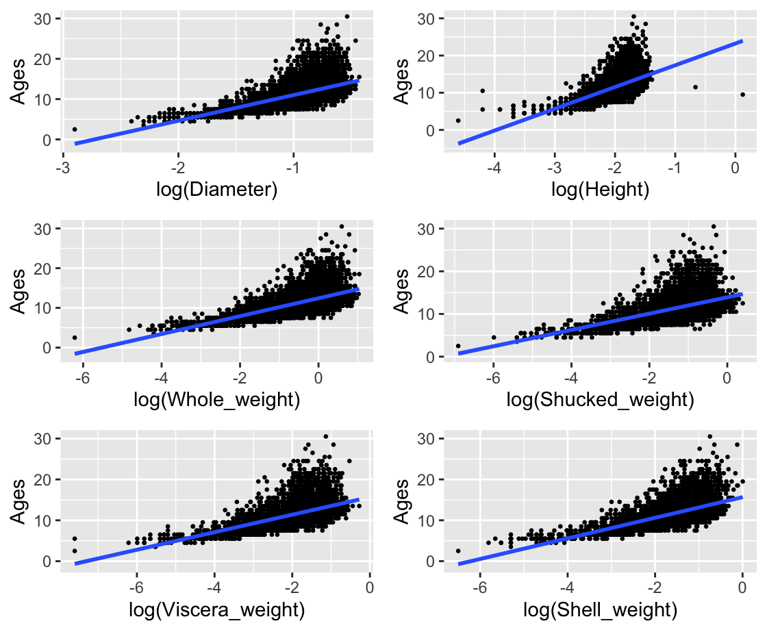
model 2 Linearity check

Slide 4
The log-transformed predictor variables generally exhibit a linear relationship with Ages, as expected in a linear regression model.

Slide 5
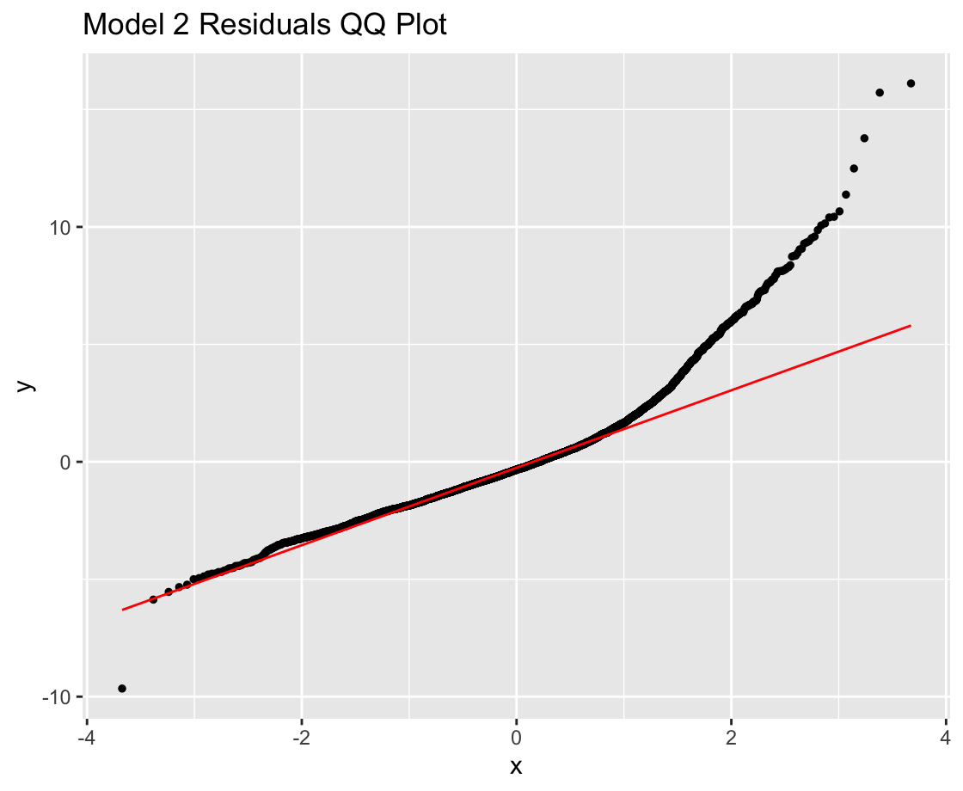
A3-A4 Transfer to Model 3

Slide 6
Model 2 exhibits problems with non-normal residuals (especially in the tails) and heteroscedasticity, as seen in both the QQ plot and residuals vs fitted plot. This suggests that the assumptions of linear regression are violated. # Model 3 and Transformation Explanation
Model 3 Formula
The formula for Model 3 with the inverse of Ages as the response variable is shown below:
$$\begin{matrix}\frac{1}{\text{Ages}}= & α+β_{1}⋅{\text{Sex}}_{I}+β_{2}⋅{\text{Sex}}_{M}+β_{3}⋅log\left(\text{Diameter}\right) \\ & +β_{4}⋅log\left(\text{Height}\right)+β_{5}⋅log\left(\text{Whole_weight}\right) \\ & +β_{6}⋅log\left(\text{Shucked_weight}\right)+β_{7}⋅log\left(\text{Viscera_weight}\right) \\ & +β_{8}⋅log\left(\text{Shell_weight}\right)+ϵ\end{matrix}$$
the model exhibits a more linear relationship between the response and predictors

Slide 7
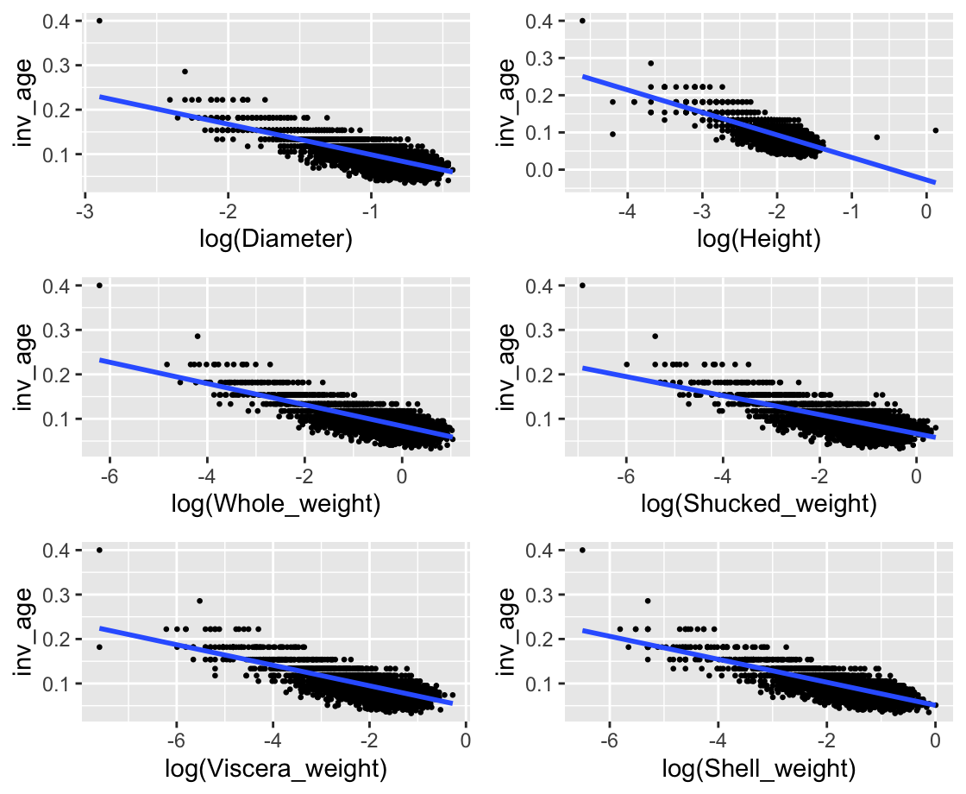
model 3 Linearity check

Slide 8
the model adequately satisfies the linearity assumption, with only minor deviations for some predictors.

Slide 9
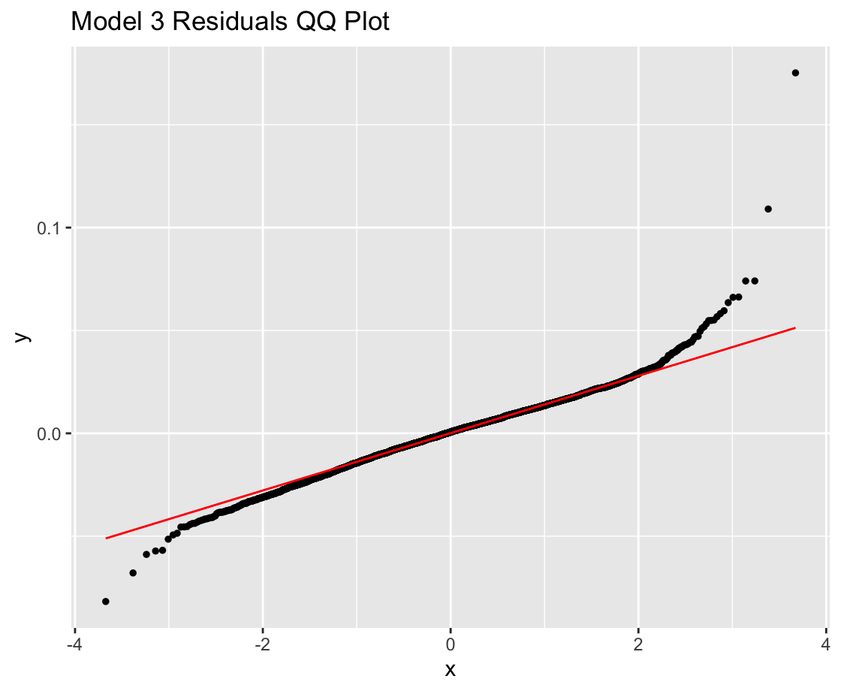
A3-A4

Slide 10
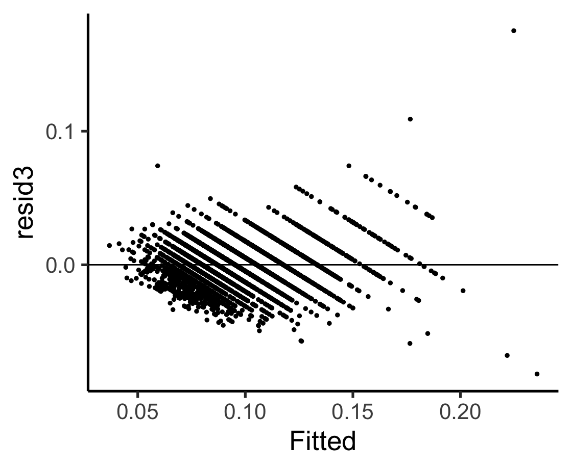

Slide 11
Model 3 improves significantly on these issues, showing better normality of residuals and addressing heteroscedasticity. The inverse transformation applied in Model 3 has helped stabilize the variance and improve the overall model fit.

